Slide 1
Bamboo Based Sustainable Development
Indian Scenario
Dr A K Bhattacharya, IFS (R)
Former MD & CEO
MP State Bamboo Mission &
MP Bamboo & Bamboo Crafts Development Board
Presently
Chairman, Integrated Development Organization
Patron & MD, Bamboo Entrepreneurship Development Foundation
Email – ajoykb@gmail.com
Notes:
Good evening and welcome. Thanks to INBAR team, specially Dr Subramony for proving this unique opportunity to share my little knowledge with the Bamboo experts of world. Although the subject is close to my heart, I understand I am sailing a small boat in the vast ocean of bamboo sector.

Slide 2
Bamboo based sustainable development solutions
For
Post COVID Crisis Mitigation
at Community level
Notes:
In the present scenario of global COVID crisis, I look at bamboo as a potential solution for post covid crisis mitiagation at community level.

Slide 3
Post Corona Crisis Issues
Living with Virus
3 Es solutions – Employment (livelihoods); Entrepreneurship (Jobs / Occupations); Enterprise (Businesses)
Communities will be worst affected
Scope / Solutions
Local – Vocal – Global (Think locally – act locally – promote globally)
Atm Nirbhar Bharat Abhiyan – Self Reliant India Mission
Bamboo Chain of Custody in place –
Natural resource – Human Resource – Technology - Market
Bamboo based Sustainable Developent
Notes:
WHO & other experts indicate that now we have to find solutions to live with the virus. Bamboo can provide the 3 Es solutions to combat this crisis - Employment (livelihoods); Entrepreneurship (Jobs / Occupations); Enterprise (Businesses). For Indian Prime Minister’s vision of Local – Vocal – Global & Self Reliant India Mission, bamboo is the most appropriate commodity. The entire chain of custody – the natural resource, bamboo; the human resource, the artisans; technology, machinery & tool; and the market, are in place, just a trigger is needed.

Slide 4
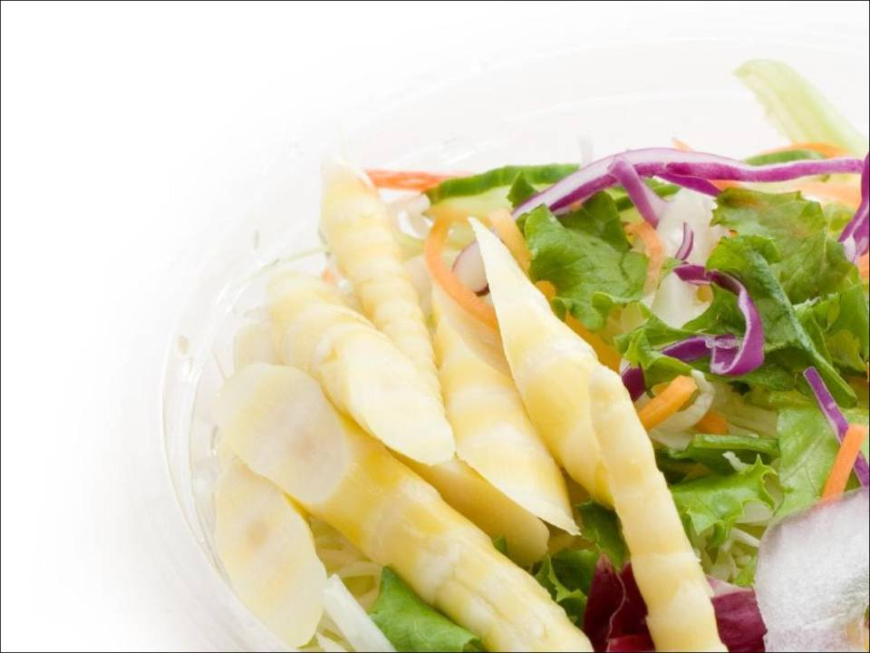
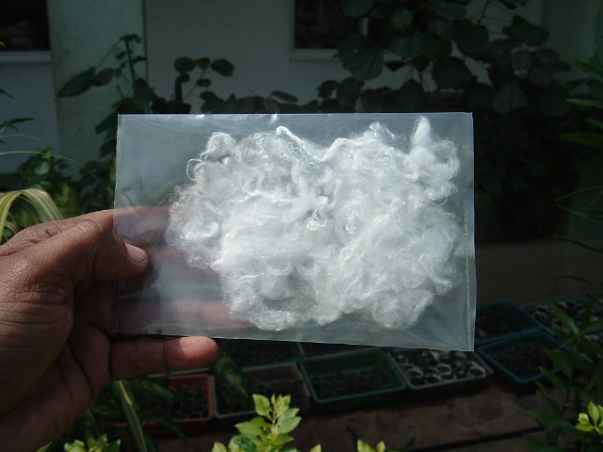
Bamboo – The versatile wonder
One product for three basic human needs
Food
Clothe
Shelter
Notes:
The versatile bamboo provides all basic needs for human existence – Food, clothe & shelter

Slide 5
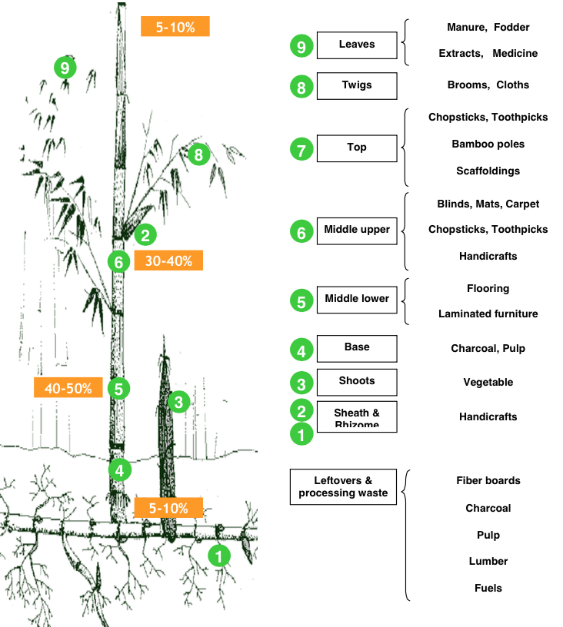
VERSATILE BAMBOO
Bamboo serves the most ordinary as well as the most refined purposes
Every part of bamboo has unique utility.
Which makes it the most robust and versatile crop/raw material.
Notes:
Probably bamboo is the only species with 100 % utility – every part is used.

Slide 6
Bamboo is both a Grass and a Tree – 100 % species Fits in both Agriculture and Forestry.
Bamboo based Sustainable Development
Notes:
Bamboo is both grass & tree – both agriculture & forestry – a 100 % species

Slide 7
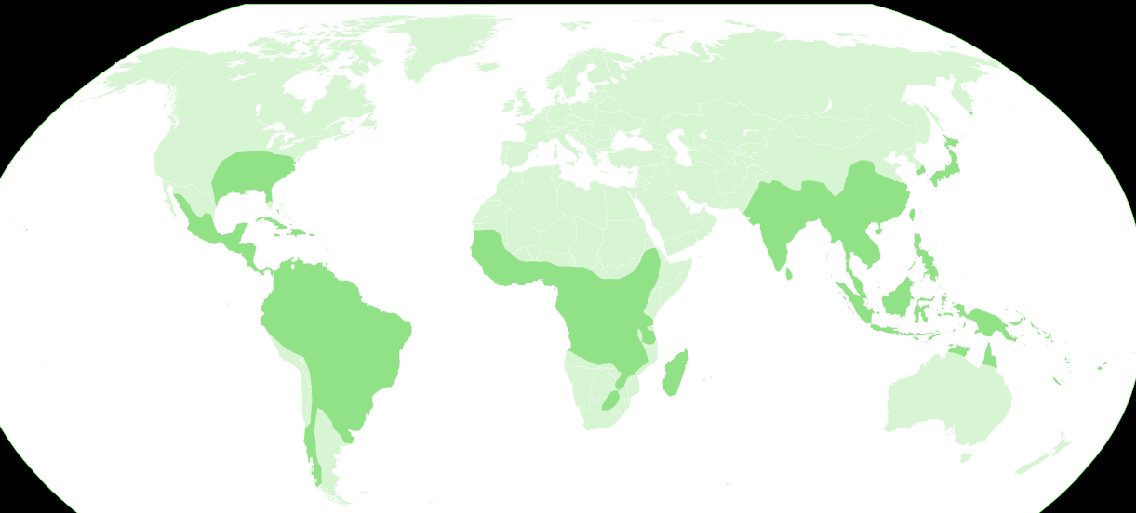
Distribution of Bamboo across Globe
Asian countries have 80 % of the world bamboo resources (China, India, Myanmar etc)
They can play a pivotal role in establishing Bamboo as the change agent for poverty alleviation and climate change mitigation.
Distribution of Bamboo across globe
Credit : Wikimedia Commons
Notes:
Globally, 80 % of bamboo resource exist in Asia, mainly China & India.

Slide 8
Indian Bamboo in global perspective
About 50 m ha area of the world (3.2% forest cover); by area, India (30%), China (15%)
About $60 bn market worldwide
Major Exporters- China, The Netherlands, Thailand, Vietnam
Major Importers- India, US, The Netherlands, Spain
Despite having largest area, India contributes to only 4% share of the global market – production 4.6 million Tonnes
India has not been able to tap the market despite being the second-largest bamboo producer in the world after China.
North East India comprises 35% bamboo area and 45% growing stocks in the country
Madhya Pradesh share of bamboo area is 11.6% and growing stock is 8.60% in the country
Bamboo is the material for future
Bamboo based Sustainable Development
Notes:
India contributes around 30 % of global bamboo area, 19 % production share but hardly 6 % global market share

Slide 9
India vis a vis the world
Bamboo production
Production Share
India – 19%
Rest of Asia – 46%
Africa – 28%
Latin America – 7%
Bamboo trade
Trade Share
India – 6%
Rest of Asia – 87%
Africa – 6%
Latin America – 1%
Notes:
Source TRIFED (S.S. Maiti) – production
World bamboo markets: Preliminary analysis of selected bamboo product markets, N Smith, K Key and J Marsh, 2006. The ten product lines chosen are Handicrafts, Blinds, Bamboo Shoots, Chopsticks, Furniture, Panels and Boards, Flooring, Carpentry, Charcoal and Activated Carbon.
UN comtrade

Slide 10
India vis a vis China
Parameter | China | India
Bamboo Area (million ha) | 6.41 | 16.00
Production (no of culms - million) | 3,50,000 | 42500
Revenue – annual USD | 40 billion | 1460 million
Jobs (Number) | 350 lakh | 86000
Households (Number) | 126 lakh | 21500
Average productivity | 20 tons/ha/year | 2 tons/ha/year
Domestic demand |  | 26.69 mill MT
Share in global market ~ | > 80 % | < 6 %
Bamboo based Sustainable Development
Notes:
As compared to China, although India has more than double the bamboo area, but the production is very low, so output is very low.

Slide 11
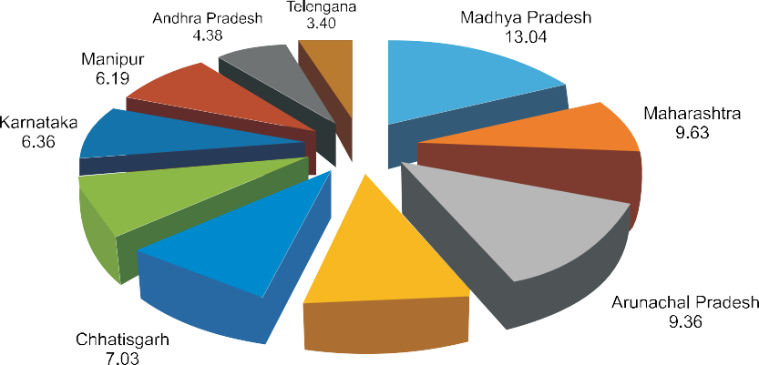
State wise distribution of Bamboo in India Top 10 states bamboo bearing area (%)
Bamboo based Sustainable Development
Notes:
Madhya Pradesh state has the largest bamboo bearing

Slide 12
Bamboo in India
India owns world’s largest bamboo area
India is the second richest country in terms of Bamboo genetic diversity with a total of
136 species under 25 genera
125 indigenous and 11 exotics
Spread over around 16.00 million ha of forest areas
i.e. 22% of the country’s forest cover
Bamboo based Sustainable Development
Notes:
As per Forest Survey of India report, India’s Bamboo forests spread is around 16 m ha, which is 22 % of forest cover. India has around 136 bamboo species.

Slide 13
Bamboo in India
Area under bamboo in forests : 16.00 m Ha
Area under bamboo outside forests : 03.29 m ha
Number of Culms in Forests : 39454 m no
Number of Culms outside forests : 3046 m no
Current estimated demand : 26.60 m ton
Current supply : 13.47 m ton
Existing gap : 13.22 m ton
Bamboo based Sustainable Development
Notes:
Bamboo area outside forests is 3.29 m ha. The huge supply demand gap provides an extensive opportunity for bamboo based development.

Slide 14
Distribution of Bamboo in India
Bamboo based Sustainable Development
Notes:
Presently, NE with around 28 % of bamboo area contributes around 66 % of growing stock

Slide 15
Indian Bamboo Industry in infant stage
The bamboo and rattan industry of India is worth Rs. 28,005 crores.
During 2015-16 & 2016-17 the export of bamboo & bamboo products was Rs. 0.11 crore and Rs. 0.32 crore respectively while the import was Rs 148.63 crores and Rs 213.65 crores.
Bamboo based Sustainable Development

Slide 16
Indian Bamboo Industry potential
Indian bamboo industries has a size of Rs. 2040 crore/ year at present, while the domestic market potential is US$ 10 bill.
Employment generation annually – 516 m MD
Income generation annually – US$ 1032 m
Bamboo based Sustainable Development

Slide 17
Present Contribution of Bamboo in National Development
Social – About 86 million Indians depend upon Bamboo for their livelihoods
Environmental – Potential Carbon Sequestration value : 1210 M MT / year (Forests – 980 MMT; BOF – 230 MMT)
Economic – About INR 500 billion (USD 670 million) worth of market exists for bamboo and its products
Bamboo based Sustainable Development
Notes:
http://www.tradingeconomics.com/india/gdp – 1876.8 trillion dollar

Slide 18
Market Potential of Bamboo Based Products in India
Source - Planning Commission and NMBA
Bamboo based Sustainable Development

Slide 19
Bamboo based Sustainable Development
Current estimate of the market for
bamboo products : ~ Rs 50,000 crore
(approximately US $ 10 Billion )

Slide 20
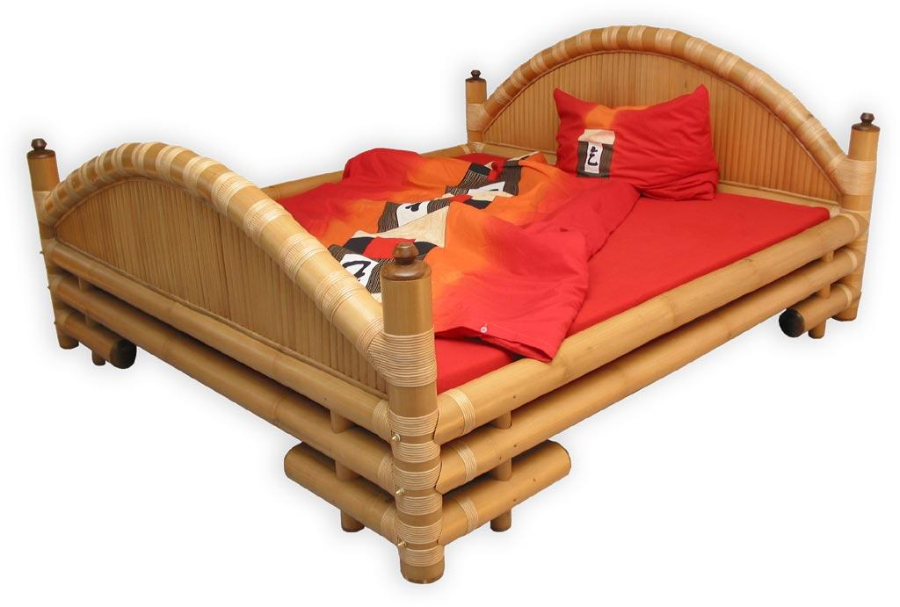
Bamboo Furniture - 3625 Crore
Bamboo based Sustainable Development

Slide 21
Bamboo Shoots - 300 Crores
Bamboo based Sustainable Development

Slide 22
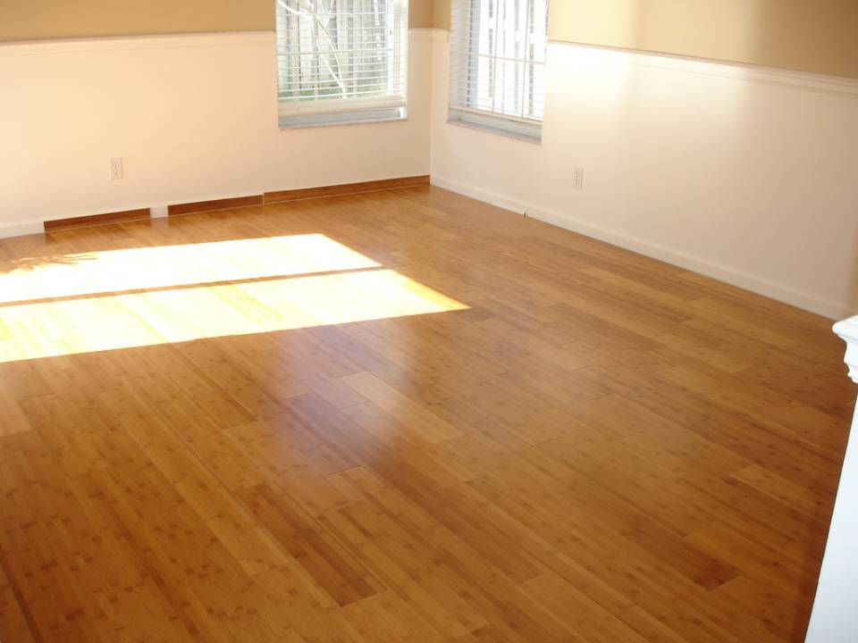
Bamboo Flooring - 1950 Crore
Bamboo based Sustainable Development

Slide 23
Bamboo Pulp – 2088 Crore
Bamboo based Sustainable Development

Slide 24
Bamboo Housing – 1,163 Crores
Bamboo based Sustainable Development

Slide 25
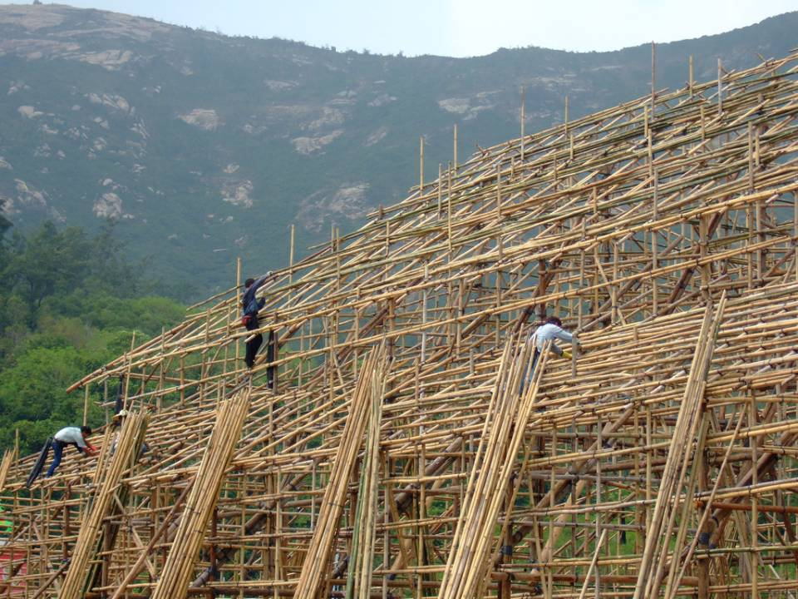
Bamboo Scaffolding – 861 Crore
Bamboo based Sustainable Development

Slide 26
Bamboo Mat boards – 3908 Crore
Bamboo based Sustainable Development

Slide 27
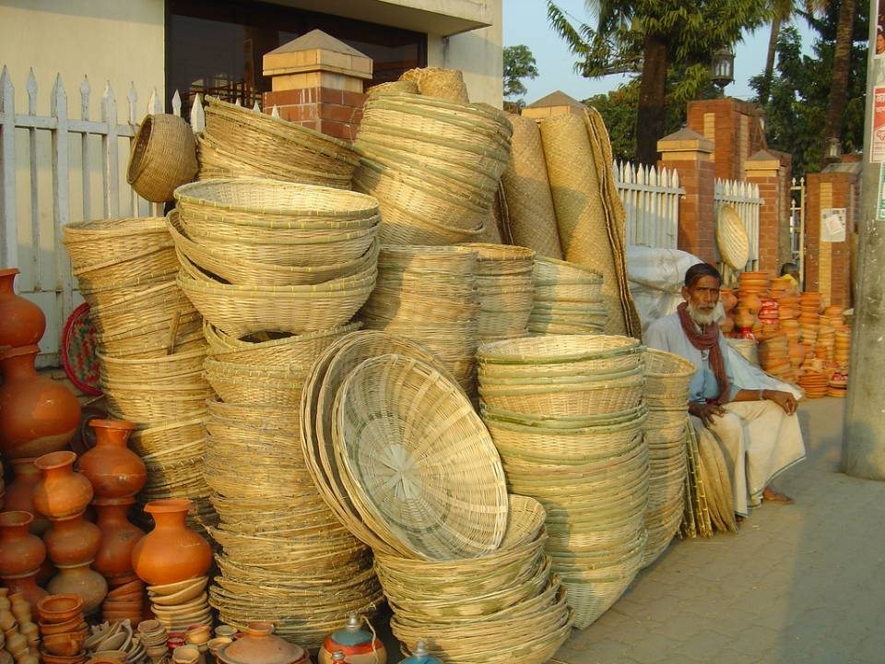
Miscellaneous Industry - 600 Crore
Bamboo based Sustainable Development

Slide 28
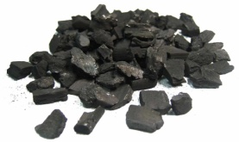
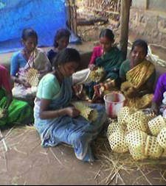
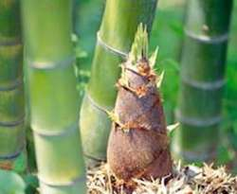
Bamboo based Economy
Bamboo
Economy
Farming
Bio-energy Industry
Furniture industry
Building Industries
Pulp & Paper Industry
Textile Industry
Craft Industry
Food and Beverage Industry

Slide 29
Sustainable Marketing potential
Huge supply demand gap
Growers do not have market access
Potential buyers do not have resource access
– no idea of suppliers
Proposed web portal for growers / buyers
Bamboo based Sustainable Development

Slide 30
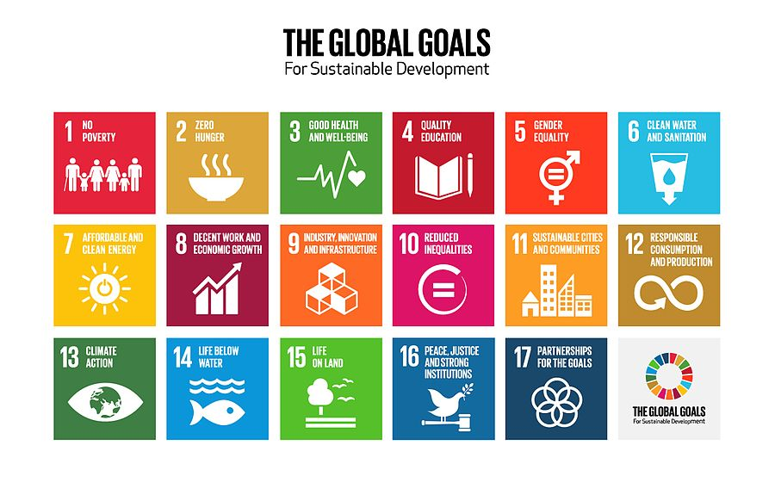
Convergence of bamboo WITH sustainable development goals

Slide 31
Convergence of Bamboo with SDGs
Bamboo- Impact Base
Economic
Gender Equality
Social
Ecological
Energy
Security
Lifestyle
Notes:
Bamboo development has been considered as a significant tool to fulfil India’s commitment towards SDGs by creating an additional carbon sink

Slide 32
Role of Bamboo in sustainable development
Shelter security, through the provision of safe, secure, durable and affordable housing and community buildings.
Livelihood security, through the generation of employment in planting, primary and secondary processing, construction, value-added products.
Ecological security, by conservation of forests through timber substitution, as an efficient carbon sink, and as an alternative to non-biodegradable and high-embodied energy materials.
Food security through bamboo-based agro-forestry systems, by maintaining the fertility of adjoining agricultural lands, and as a direct food source
Energy Security – as an alternative clean fuel; ethanol and bamboo pellets.
UN resolution for transforming world by 2030, through concerted efforts for achieving Sustainable Development Goals, specifically SDG no. 1 (No Poverty), 2 (Zero Hunger), 7 (Affordable & Clean Energy), 8 (Decent Work & Economic Growth), 9 (Industry, Innovation & Infrastructure), 11 (Sustainable Cities & Communities) & 13 (Climate Action).

Slide 33
Bamboo Development Initiative in India
In 1999, UNIDO and GoI - Seminar on Bamboo Sector Development.
International agencies like INBAR, UNDP, IFAD, UNIDO working on bamboo .
National Bamboo Mission (NBM) under MOA and National Mission on Bamboo Application (MNBA) under DST
Various agencies and Ministries like MOEF, DCH, MSME, NID, Ministry of Labour RD Department, Tribal Affairs, KVIC etc.
IIT, Bombay and NID have taken up bamboo product development projects.
State Governments have now bamboo related offices and policies.
Bamboo Development Agencies and boards being created in some states.
Bamboo based Sustainable Development

Slide 34
Policy Initiatives
The National Bamboo Mission (NBM) was launched as a Centrally Sponsored Scheme in 2006-07 at federal level under Ministry of Agriculture & Farmers Welfare
The Mission envisages promoting holistic growth of bamboo sector by adopting area-based, regionally differentiated strategy and to increase the area under bamboo cultivation and marketing.
Bamboo based Sustainable Development

Slide 35
Policy Initiatives
At the state level, the State Bamboo Missions (SBM) will be responsible for implementation and overall coordination of NBM within the State. SBM have been set up in each State headed by the Mission Director, as nominated by the State Govt. SBM will have representatives from concerned departments such as Forests, Agriculture, Industries, Rural Development, etc. The Panchayati Raj Institutions and statutory cooperative institutions existing in the State (for example Regional Directorate of NCDC) would be fully involved in the implementation of NBM activities.
Bamboo based Sustainable Development

Slide 36
Policy Initiatives - Ease of business
Ordinance for smooth transport
Ordinance Summary
The Indian Forest (Amendment) Ordinance, 2017 was promulgated on November 23, 2017. It amends the Indian Forest Act, 1927. Under the Act, the definition of tree includes palms, bamboos, stumps, brush-wood and canes.
Amendment
The Ordinance amends this definition to remove the word bamboos. Following this, bamboo growing in non-forest areas will be waived off the requirement of permission for its felling or transportation for economic use.
Incentives & Subsidy for
Farmers
Entrepreneurs
Bamboo based Sustainable Development

Slide 37
Policy Initiatives – Institution Building
District level – First Bamboo Development Authority of the country in MP
State level- Proposed State Bamboo Development Authority
Federal level- Proposed National Bamboo Development Authority
Bamboo based Sustainable Development

Slide 38
Bamboo as a Change Agent for Better Country
LIVELIHOOD & ENTREPRENEURSHIP OPPORTUNITIES
Bamboo- Change Agent
Economical
Gender Equality
Social
Ecological
Energy
Lifestyle

Slide 39
Bamboo leaves as fodder
Goats making a beeline for bamboo fodder
Sheep preferentially eating bamboo leaves
Bamboo based Sustainable Development

Slide 40
Donkeys are given bamboo leaves (Ethiopia)
Donkey eating bamboo leaves – commonly twice a day
Bamboo leaves are a commodity sold at markets
Bamboo based Sustainable Development

Slide 41
Bamboo leaves: feed for chicken
Chicken love bamboo leaves
Organic chicken gain 70% weight with bamboo leaves
Bamboo based Sustainable Development

Slide 42
Processing based livelihoods
Bamboo commodities in quantity – input material for quality products!
Treated and graded bamboo
Turned bamboo, squared bamboo
Square and round sticks for agarbatties, pencils, matchsticks
Slats for panel board
Slivers for interlaced (“woven”) products
Crushed bamboo and wafers for bamboo for panels
Bamboo based Sustainable Development

Slide 43
Flattening of bamboo > bamboo planks
Bamboo based Sustainable Development

Slide 44
Market based livelihoods
The more we mainstream bamboo as a material, the less would be the effort in greening the economy. That would also avoid deforestation.
Institutional markets, school furniture, school buildings, IAY housing, and others
Bamboo construction creates 90.9% rural jobs and 9.1% urban jobs! This compares well with the crafts sector, where 93.5% rural and 6.5% urban jobs were created.
Bamboo based Sustainable Development

Slide 45
Panel production by rural communities 1-2 square m/HH/day 10,000 HH can produce 10,000 sq m/day, all above the poverty line!
Bamboo based Sustainable Development

Slide 46
A Complete School Equipped with Bamboo Desks in Gujarat
Bamboo based Sustainable Development

Slide 47
Bamboo Packaging
Konkan – Bamboo School and General Furniture
Livelihood and Economic Development Programme
Bamboo based Sustainable Development
Notes:
47

Slide 48
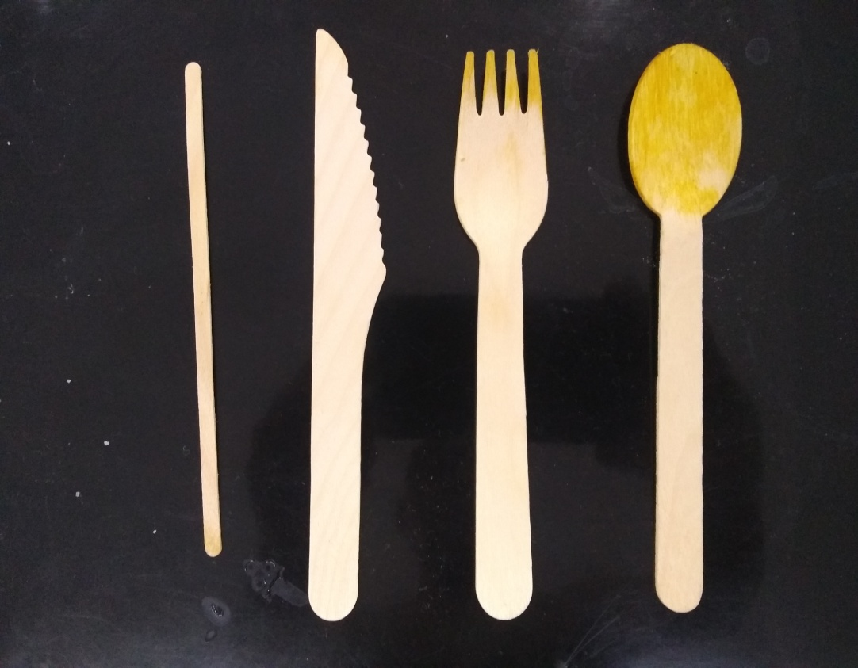
Bamboo Matchsticks (Made in India)
Cutlery in Aircraft (Made in India)
Bamboo based Sustainable Development

Slide 49
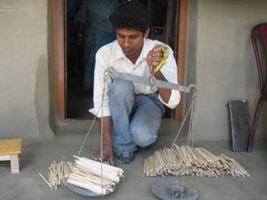
Bamboo Pencils (Made in India)
Bamboo pencils
Bamboo based Sustainable Development
Notes:
49

Slide 50
Handicrafts – baskets, mats Quality & Scale; Value in Volume
Bamboo based Sustainable Development

Slide 51
Renewable Energy Rural Livelihoods Food crops are perishable and susceptible to weather Bamboo as energy crop is not susceptible to weather Farmers = Food + Energy (Biomass, Charcoal, Power)
Bamboo based Sustainable Development

Slide 52
Degraded & Wastelands based livelihoods
Bamboo rehabilitated tens of thousands of hectares of used brickfields - won the $1 million Alcan Prize for Sustainable Development (2007)
The 68 million ha of degraded land and 52 million ha of wastelands in India (total 120 mln ha) can similarly benefit
1% of 120 m ha can benefit 1.2 million HH
Income: $0.46-$3.23/day at lowest yield of 10 tons/ha.
Bamboo based Sustainable Development

Slide 53
Carbon Capture and Storage (CCS) based livelihoods
121 million households (49% of population) use firewood
Household Charcoal from cooking (inorganic carbon)
@ 10% yield; 44.6 million tons HHC; 164 million tons of CO2 Rs 54,000 crores
@ 20% yield; 89.2 million tons HHC; 328 million tons of CO2; Rs 128,000 crores
@ 30% yield; 133.8 million tons HHC; 496 million tons of CO2; Rs 182,000 crores
Bamboo forests also capture CO2 (organic carbon)
Position bamboo as a strategic resource to mitigate and adapt to climate change in the Paris COP.
Bamboo based Sustainable Development

Slide 54
Biomass energy versus Solar energy
Biomass
Solar
Generates income
Enhances resilience
Benefits the land
Powers HH
Powers enterprises
Local employment generation
Enhanced food & water security
No batteries. Optional since 24x7 power
Enhances expenditure
Enhances indebtedness
No benefit to the land
Lights HH
None that need power
No employment generation
No
Recurrent expenditure on batteries
Bamboo based Sustainable Development

Slide 55
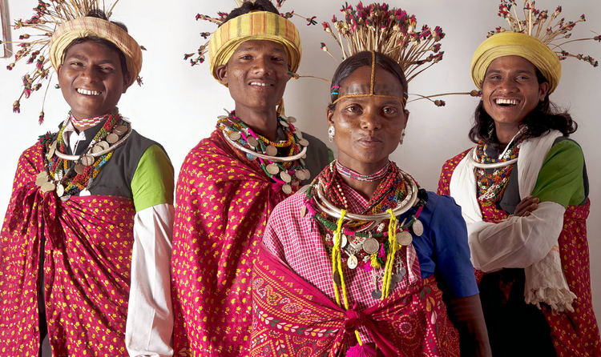
Community based High End Bamboo Enterprise
Bamboo based Sustainable Development

Slide 56
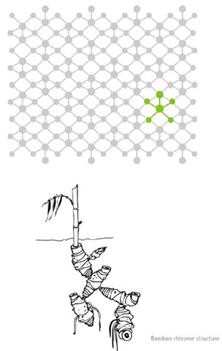
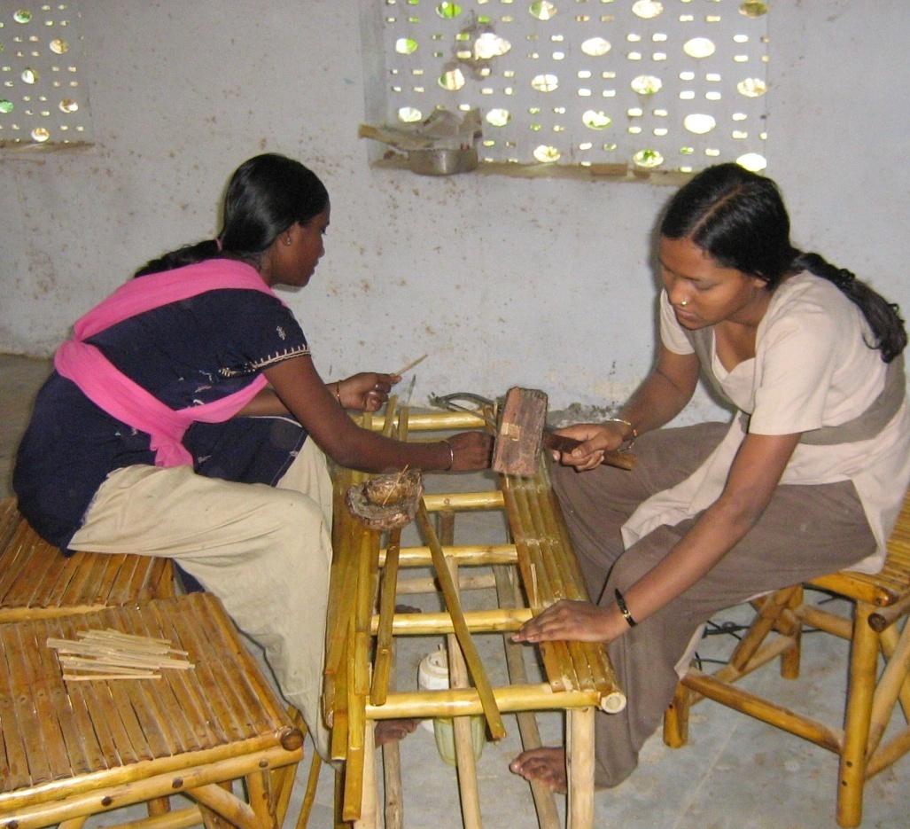
Sustainability design can help facilitate inclusive and sustainable development
PTG BPL Landless Marginalized Unsustainable craft economy
Bamboo based Sustainable Development

Slide 57
Sustainable and inclusive development by sustainability design
Bamboo based Sustainable Development

Slide 58
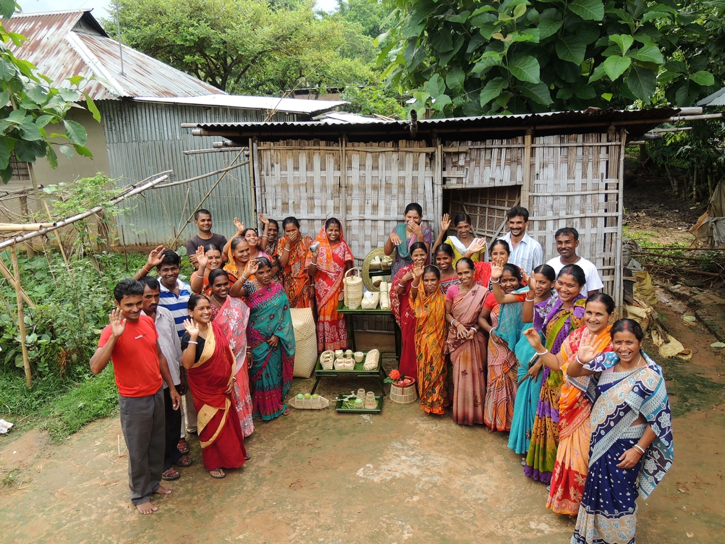
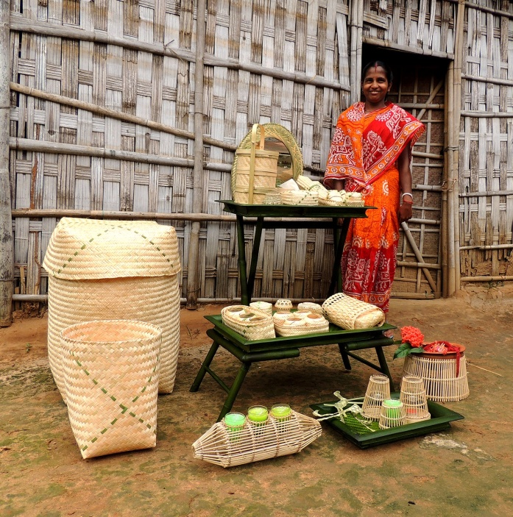
Not just telling the story…..
Full circle – return to design with Charilam cluster in Tripura
Bamboo based Sustainable Development

Slide 59
Huge interest in bamboo as an eco-friendly material
Bamboo based Sustainable Development

Slide 60
Wonderful products made from with industrially processed bamboo
Bamboo based Sustainable Development

Slide 61
gap remains between industrial and handcrafted bamboo products
?
Bamboo based Sustainable Development

Slide 62
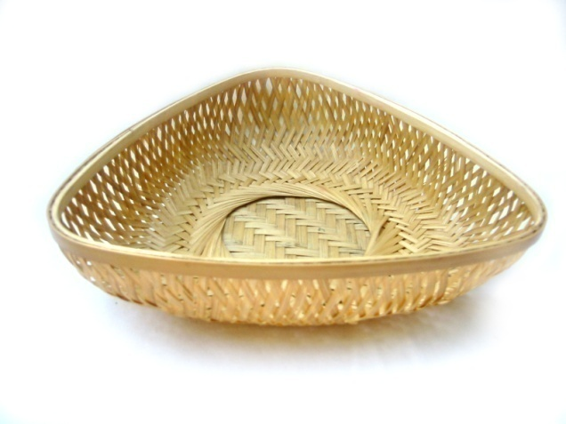
traditional applications of bamboo
Bamboo based Sustainable Development

Slide 63
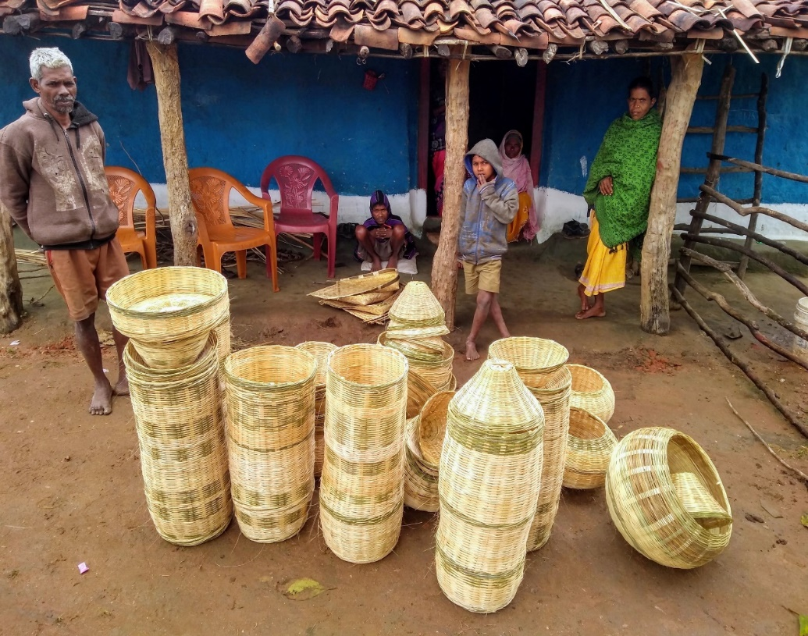
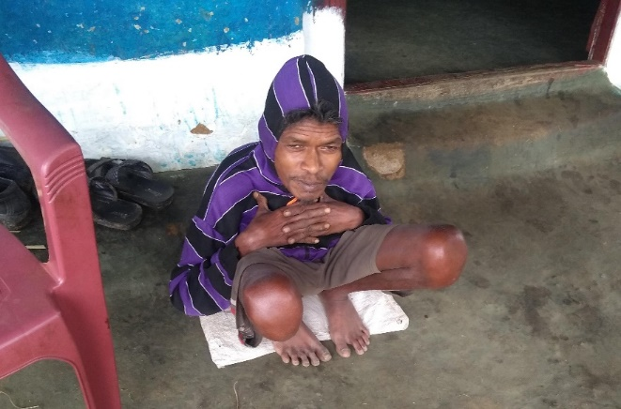
Fancy high-end lampshades made by PTG Baiga Tribe Artisans
The head artisan is physically challenged

Slide 64
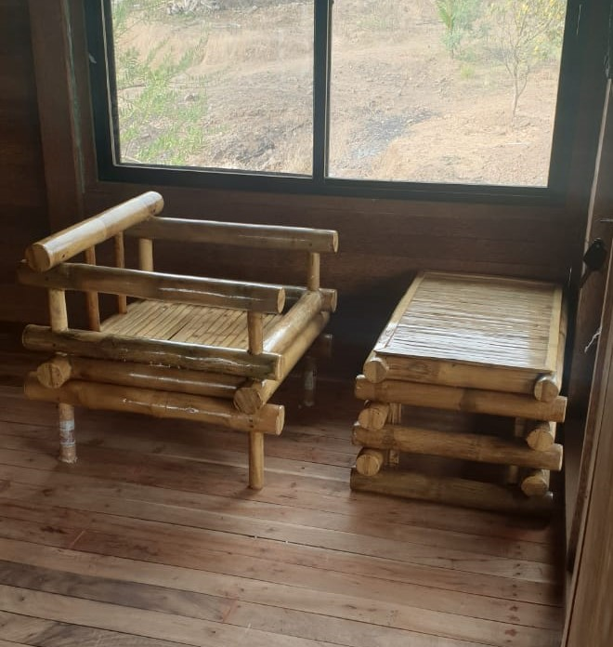
Bamboo into Bollywood Film Producer Prahlad Thakkar Purchased Bamboo Furniture from Balaghat Bamboo Centre

Slide 65
Extensive Range of products and market
Around 10000 products
From low end to high end
From rural to urban
From local to global
Bamboo based Sustainable Development

Slide 66
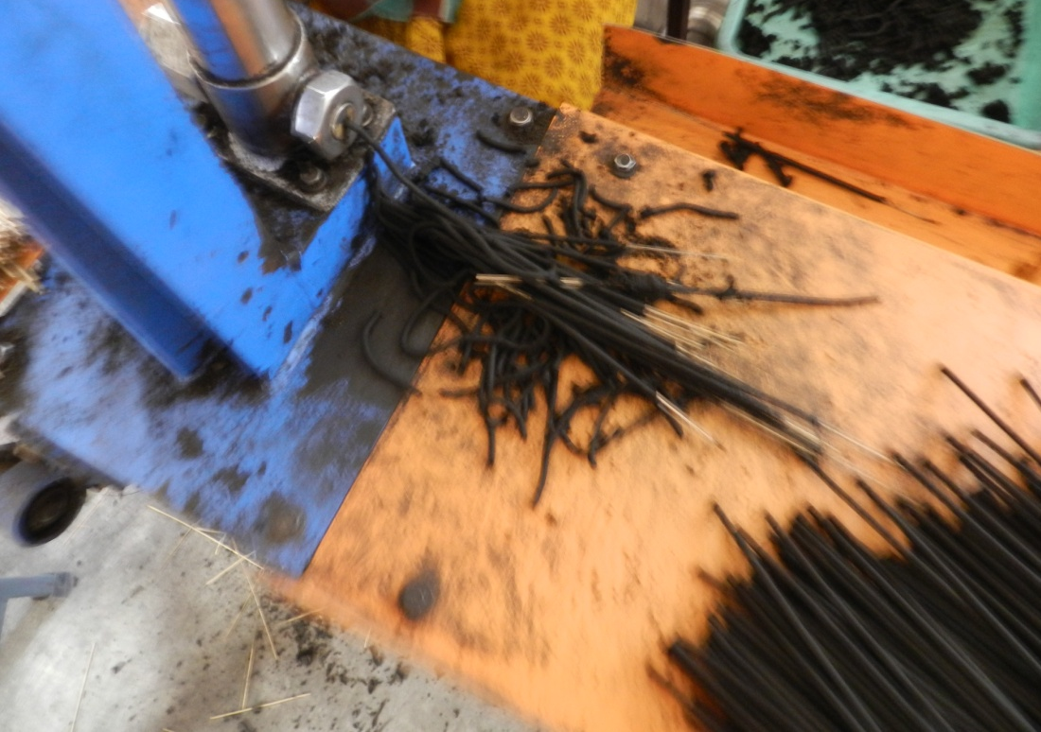
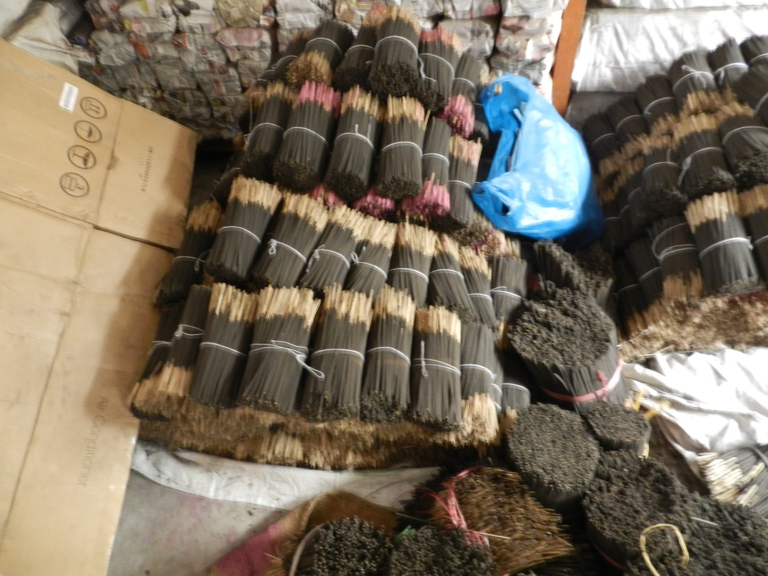
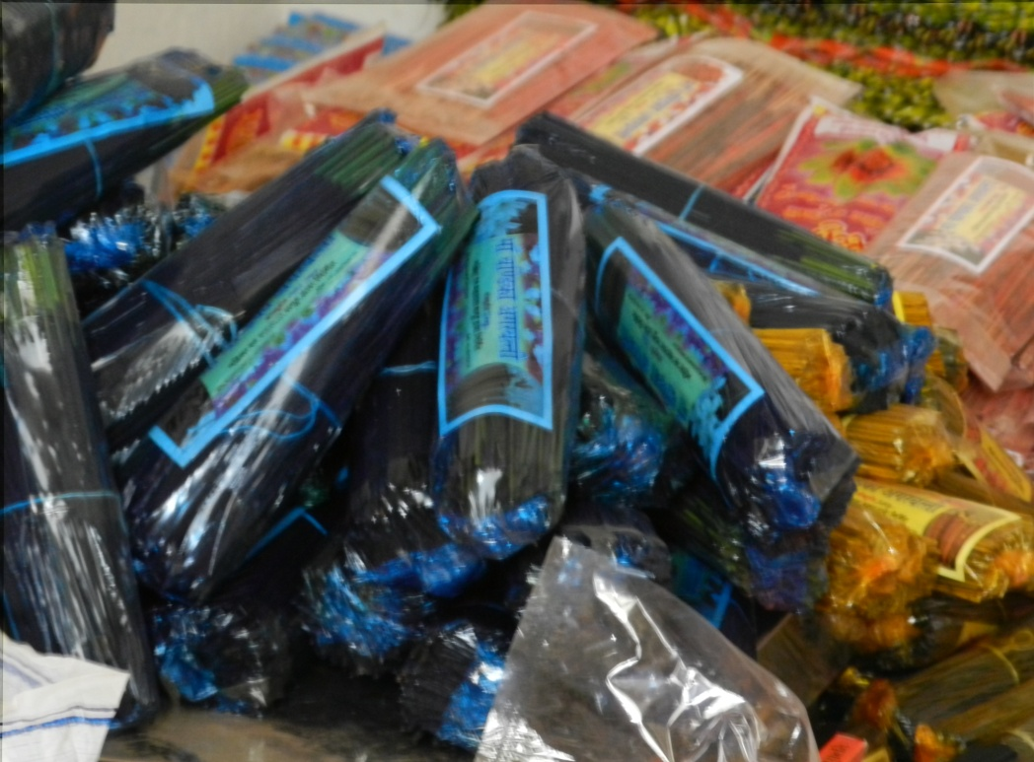
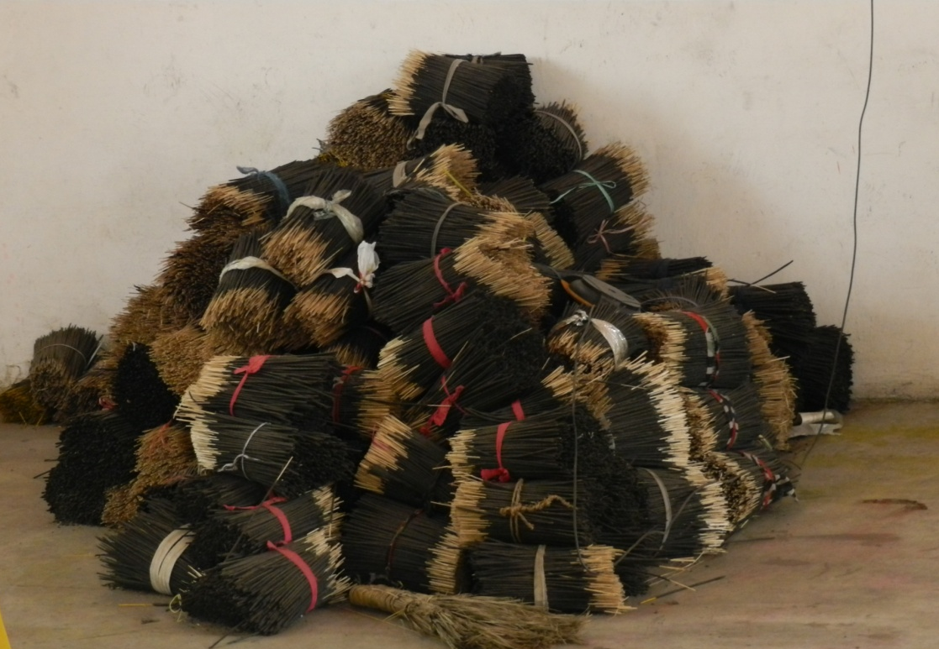
Bamboo based Sustainable Development

Slide 67
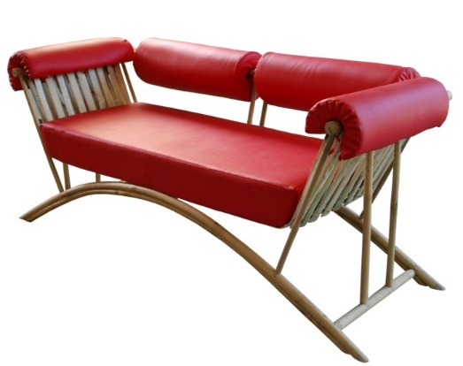
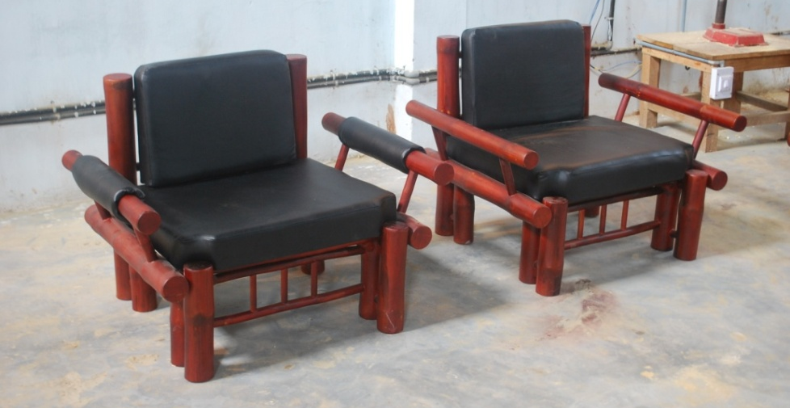
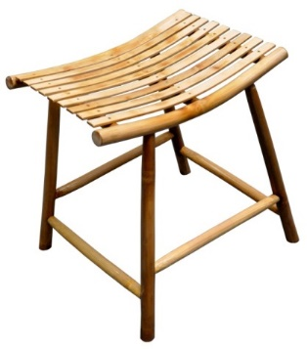
Some examples of bamboo products from NID
Bamboo based Sustainable Development

Slide 68
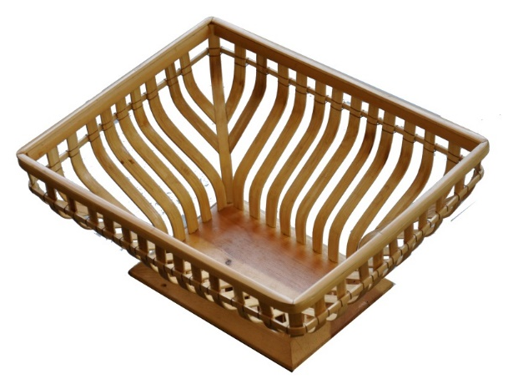
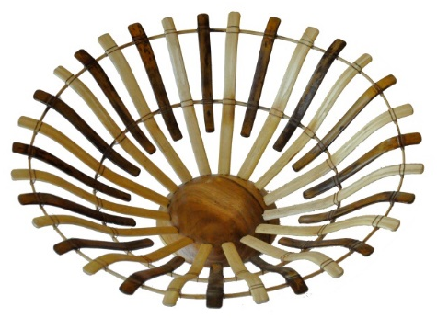
Bamboo based Sustainable Development

Slide 69
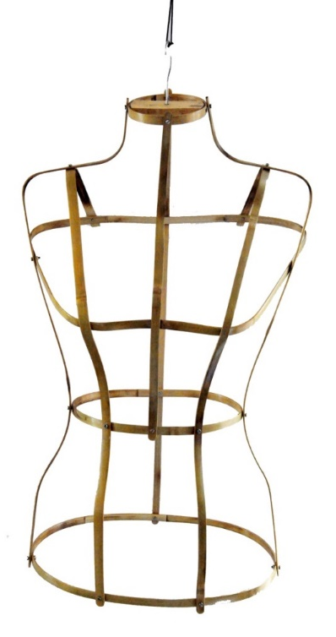
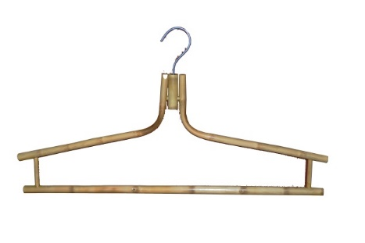
Bamboo based Sustainable Development

Slide 70
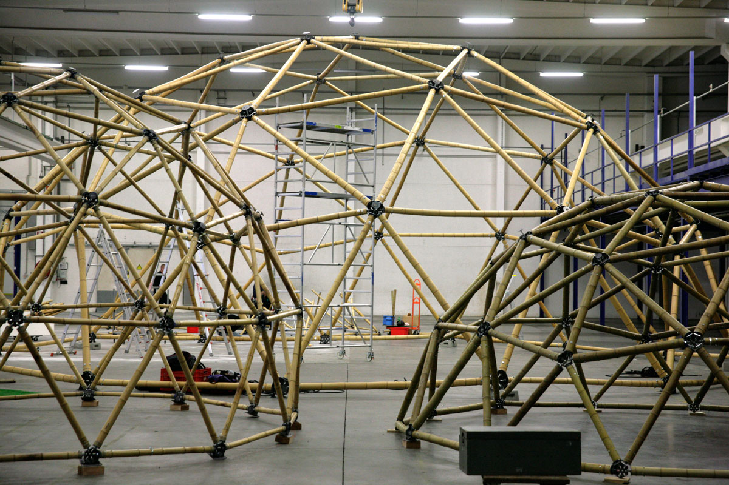

Slide 71
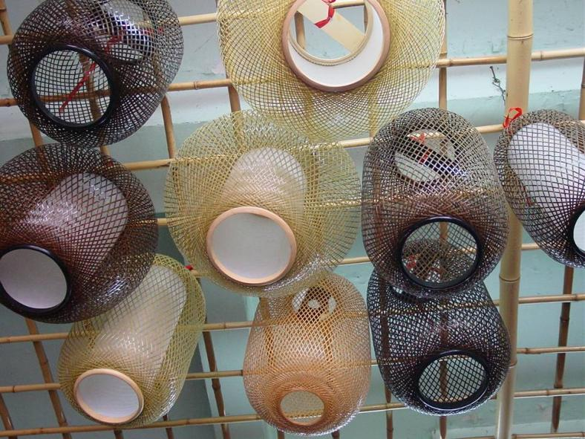
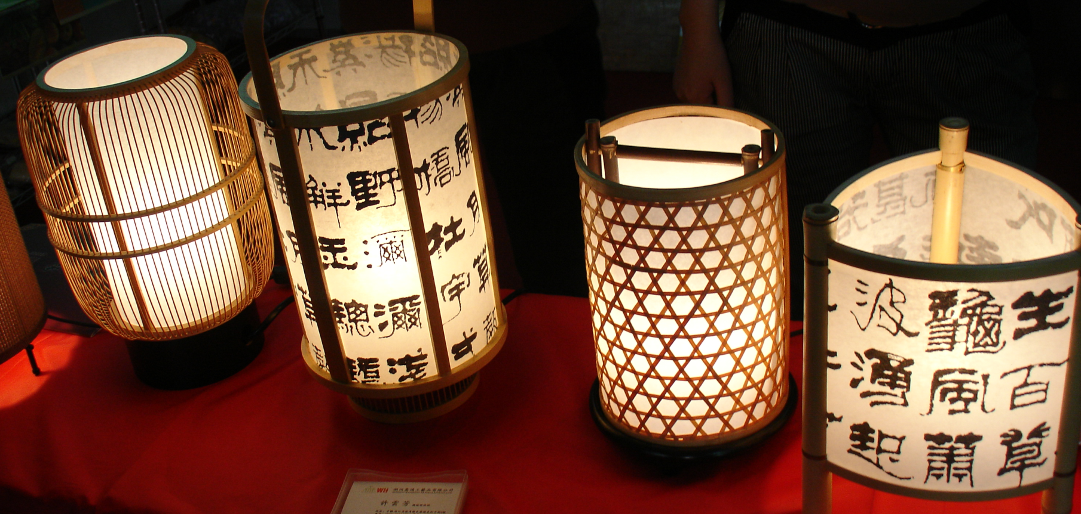
Bamboo based Sustainable Development

Slide 72
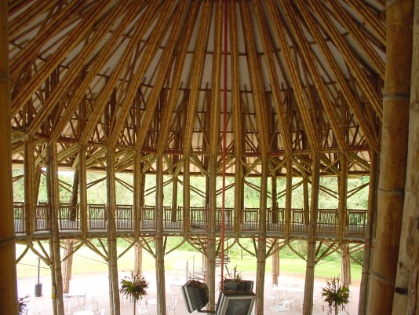
it’s strong?
Bamboo based Sustainable Development

Slide 73
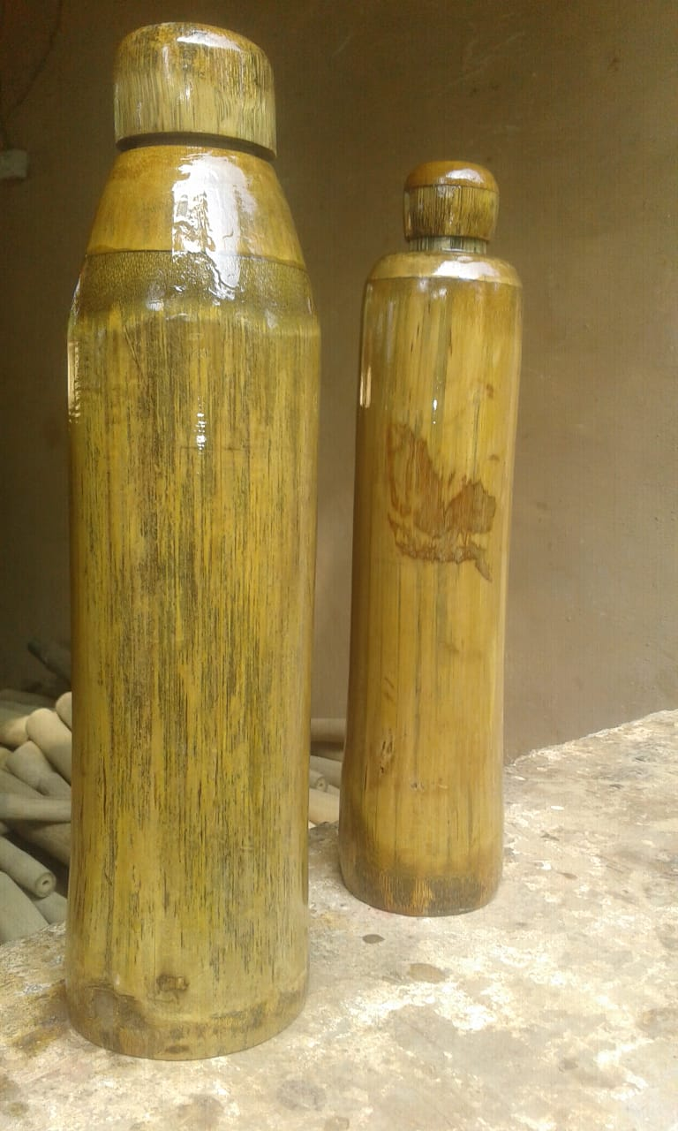
Bamboo Water Bottles

Slide 74
Bamboo – a complete utility entity
Kerwa Bamboo Centre
Bamboo blind / chik
Agarbatti (incense sticks)
Briquettes
Charcoal
Power generation (gasification)
(supply to mall thro’ dedicated grid)
Leaves to compost
Bamboo based Sustainable Development

Slide 75
New Horizons
New Applications
New Products
Bamboo based Sustainable Development

Slide 76
Bamboo Face Masks / Shields
Bamboo Men's Medical & Surgical Face Mask | Coronavirus Cloth Face Mask Cover
The Face Shop Real Nature Bamboo Face Mask (20gm)

Slide 77
Bamboo fabric garments
Bamboo based Sustainable Development

Slide 78
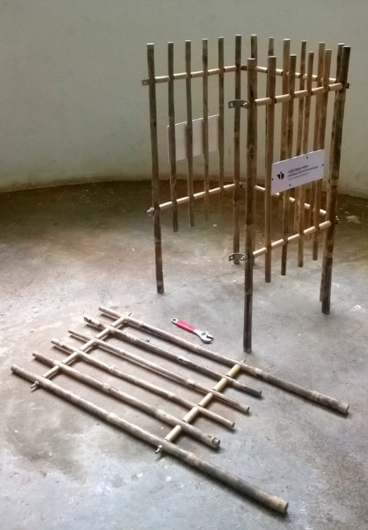
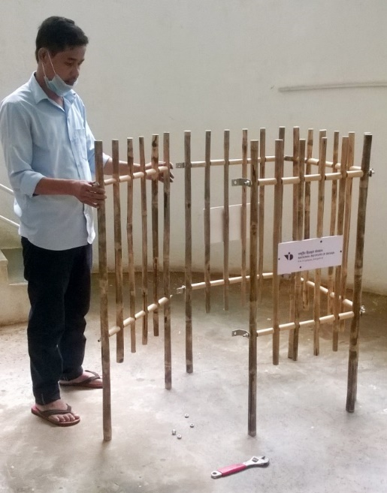
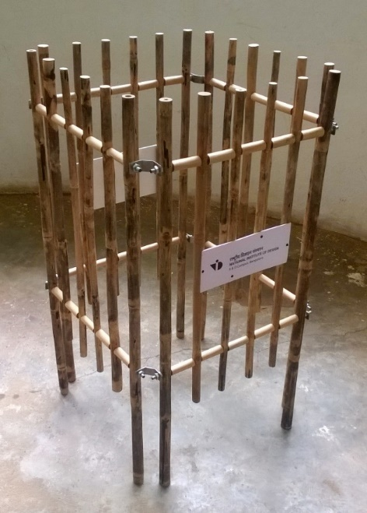
Tree Guard cum Fencing Unit
Bamboo based Sustainable Development

Slide 79
Bamboo Toll Plaza
Bamboo based Sustainable Development

Slide 80
Bamboo based Sustainable Development

Slide 81
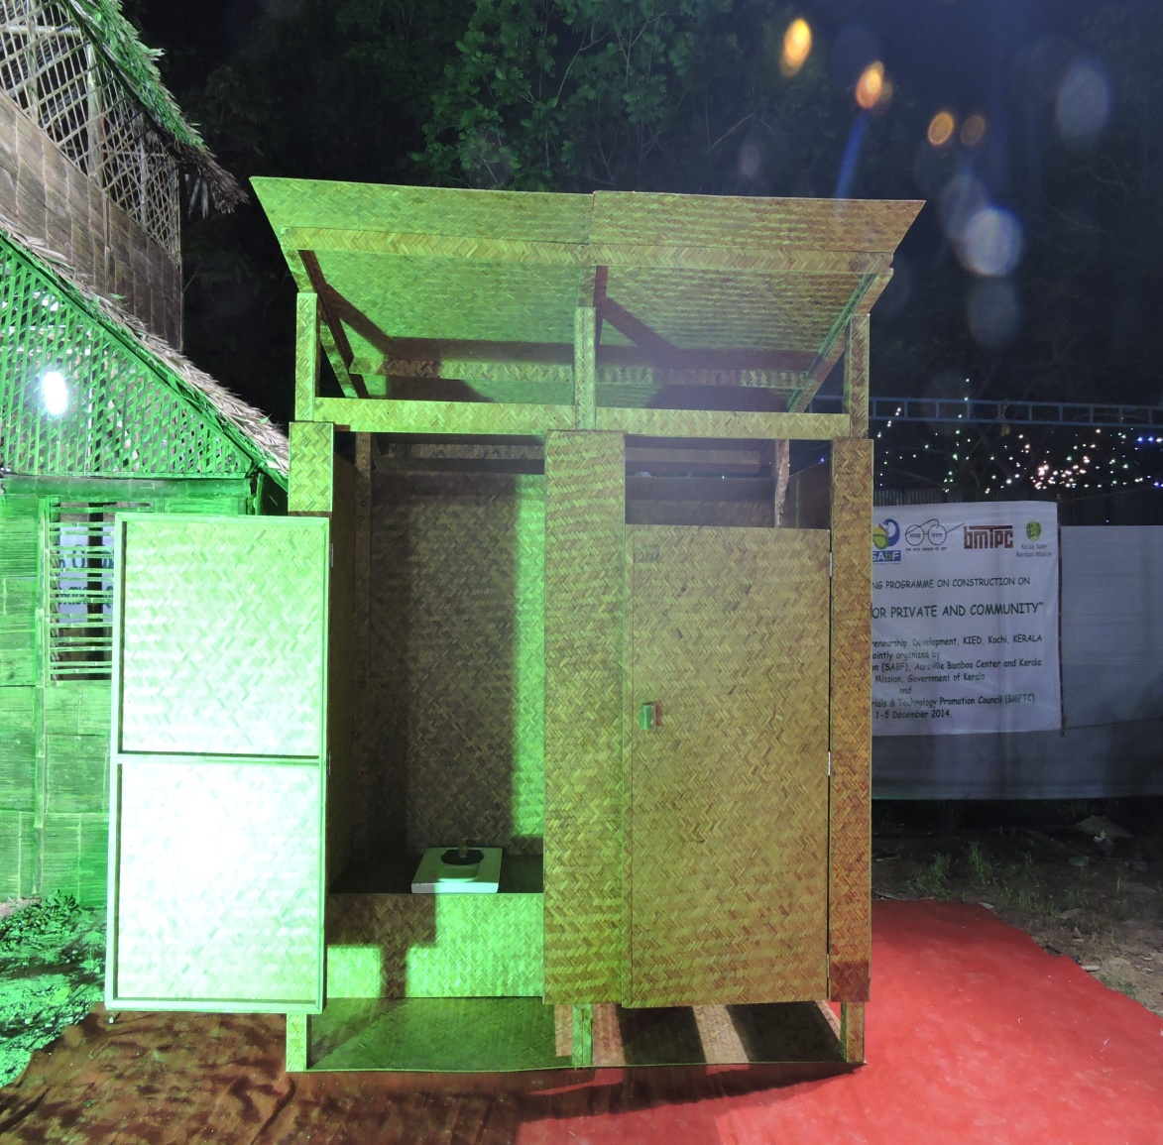
Bamboo toilets

Slide 82
Double floor Police Barrack in Delhi Got award for structural engineering excellence

Slide 83
BAMBOO BIOCHAR
Biochar is a form of high-quality charcoal that is created by heating organic waste at high temperature without the use of oxygen. It can endure in soil for thousands of years, giving it the potential to help mitigate climate change via carbon sequestration. Among its many benefits, biochar produces clean energy, builds healthy, supported soils and increases fertility, reduces the risk of water table contamination, and raises agricultural productivity.
Bamboo based Sustainable Development

Slide 84
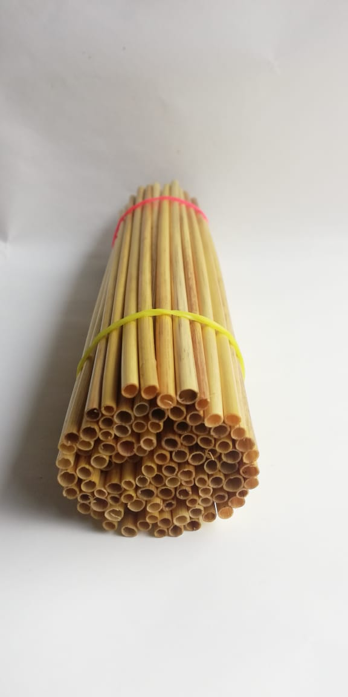
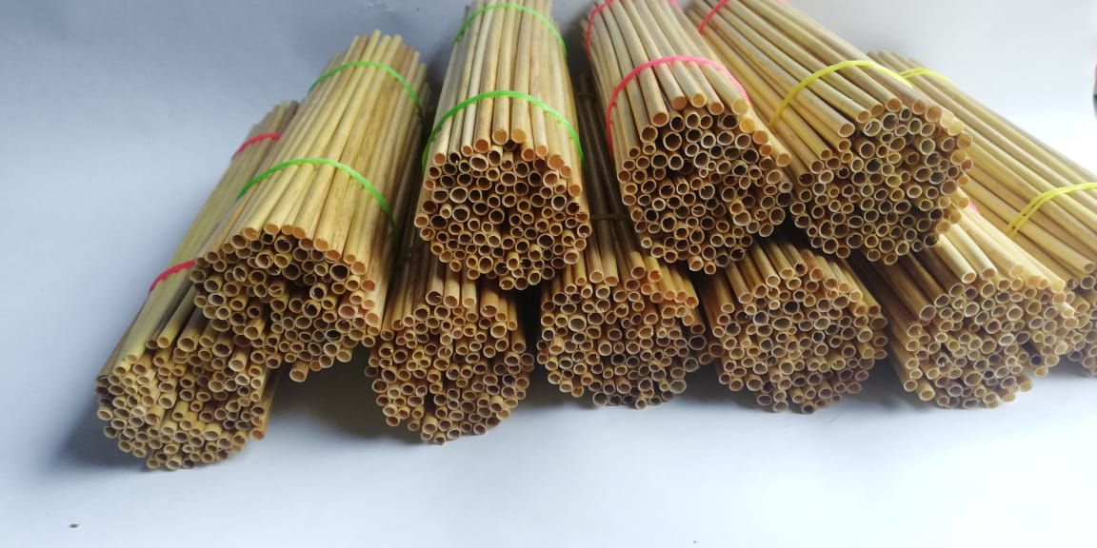
Bamboo Straw

Slide 85
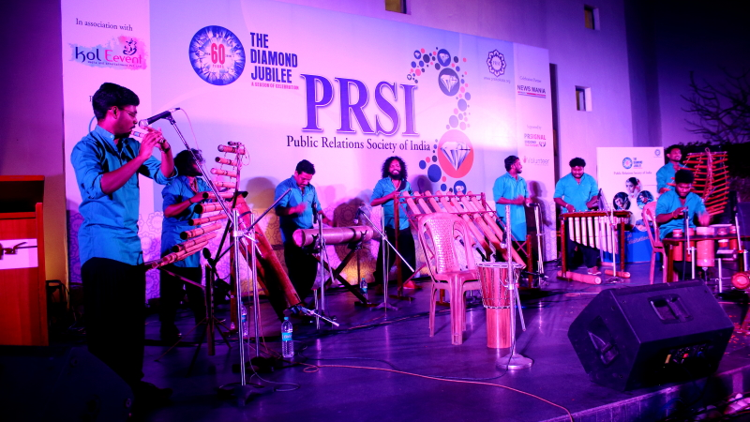
Bamboo Band

Slide 86
Few Milestone Initiatives
Bamboo based Sustainable Development

Slide 87
Bamboo Vision of Atal Bihari Vajpayee (As Prime Minister of India, 27th February, 2004, 7th World bamboo Congress)
Serious journey of Bamboo in India started in 2004 with this initiative. AVB called bamboo as GREEN GOLD & MIRACLE PLANT
“I seem to have some personal association with bamboo because of my name ‘Vajpayee’. In an ancient Indian sacrifice called “vajapeya”, bamboo seeds were offered to the fire”
There is no reason why bamboo cannot leverage itself into a position of strength in India.
Bamboo based Sustainable Development

Slide 88
Bamboo in UNFF 06-05-2015
A consultation was held on bamboo in the United Nations, at the initiative of MP Bamboo Mission in collaboration with MoEF & TERI
Most of the nations acknowledged bamboo as a tool of social and economic upliftment
Bamboo based Sustainable Development

Slide 89
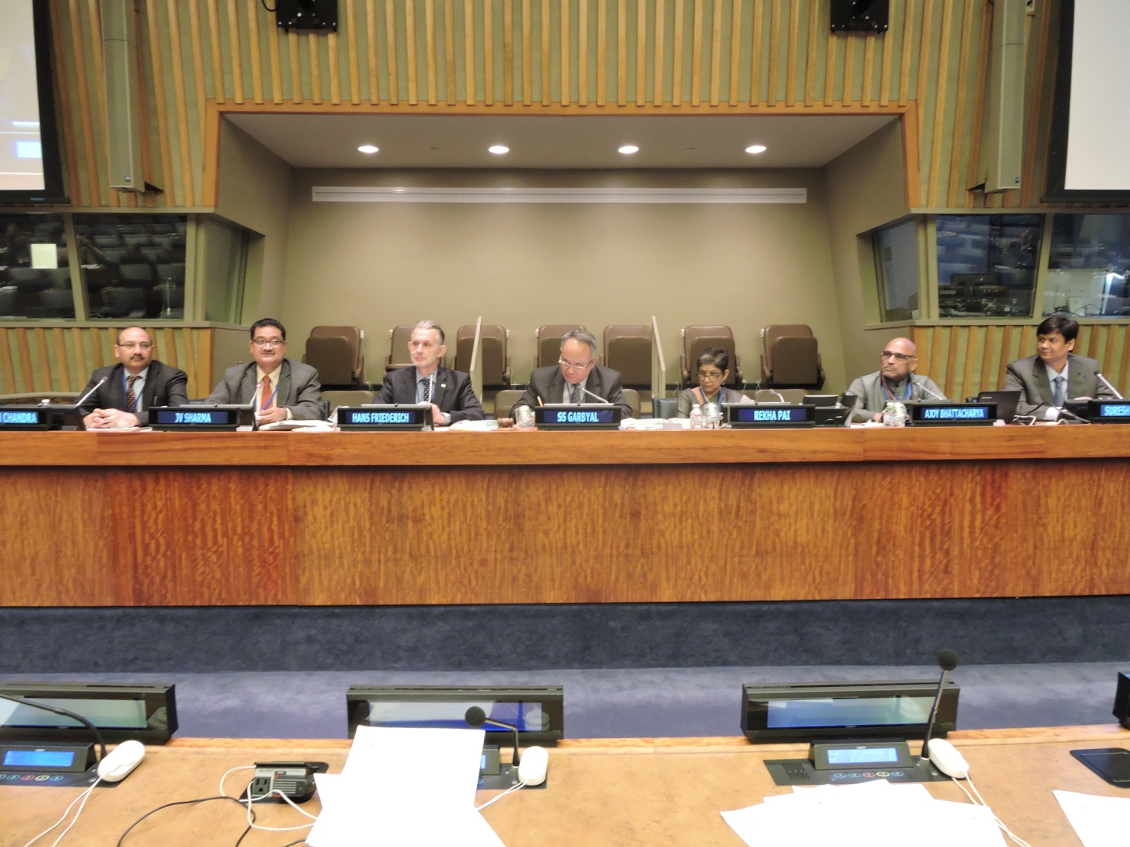
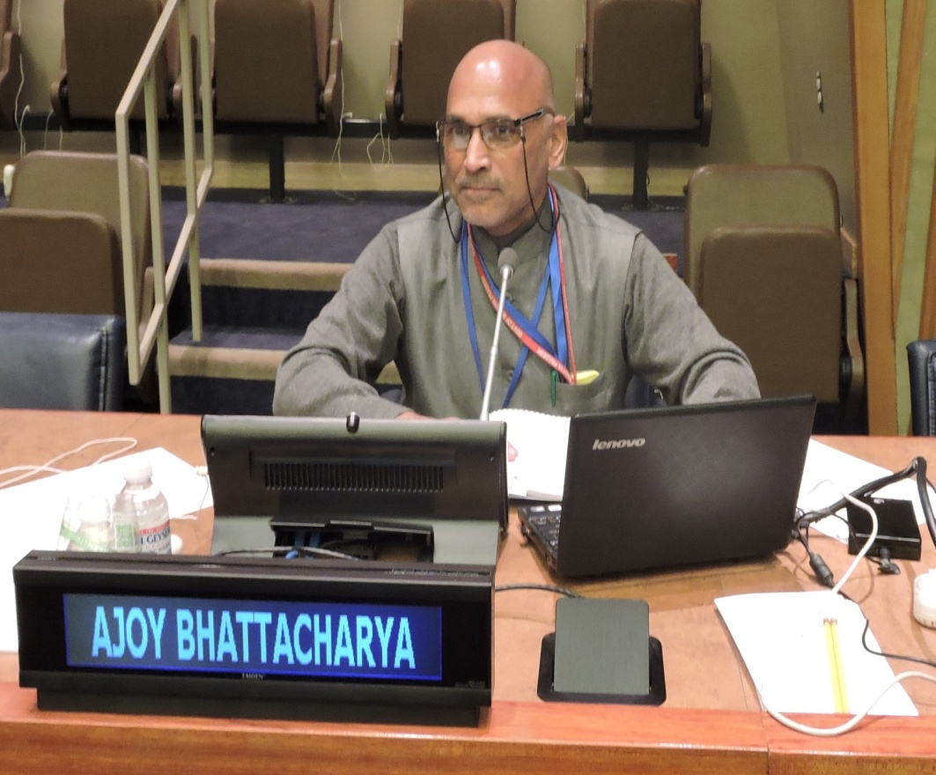

Slide 90
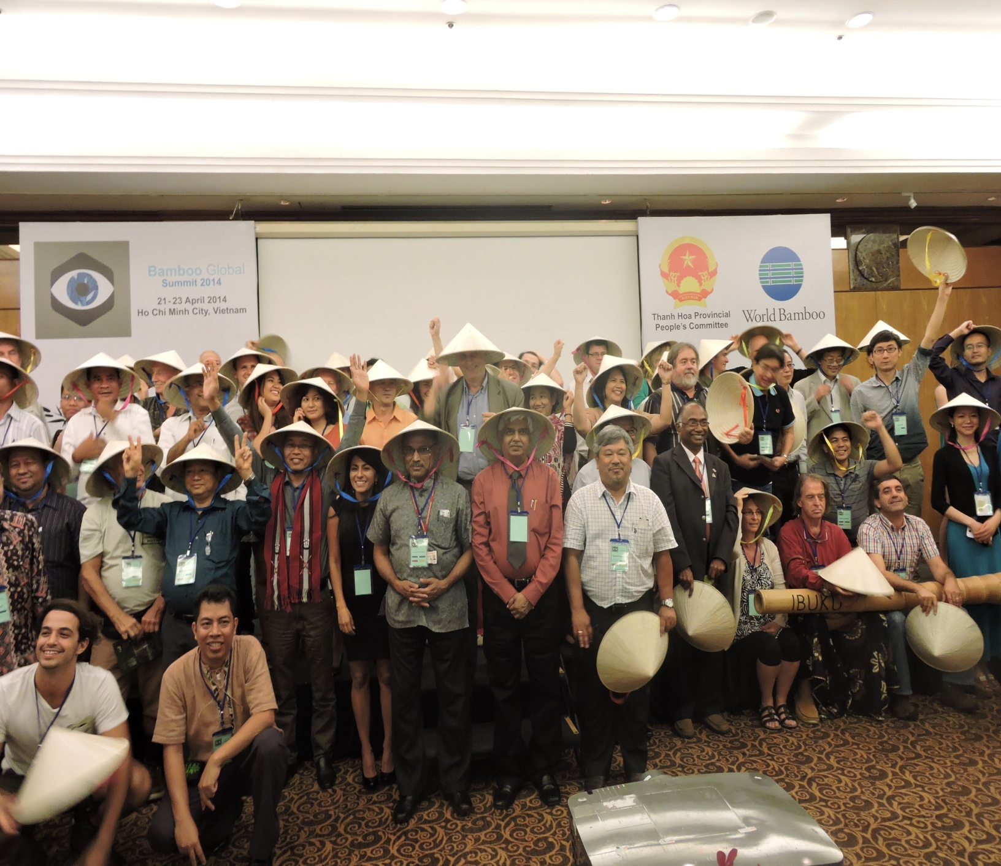
Global Bamboo Summit in Vietnam
09-04-2014
Bamboo based Sustainable Development

Slide 91
Historical Inter-ministerial Summit on Bamboo as Change Agent for a better country Eight Concerned Ministries -12-02-2015
Bamboo based Sustainable Development

Slide 92
Recommendations of Inter-ministerial Summit
Inclusion of 'Bamboo Development Task Force' in the Niti Aayog.
Constitute a committee to prepare a white paper based on the review of the efforts made in the sector so far by all the concerned Ministries.
Create National Bamboo Development Authority for Convergence of and synergy among all the Departments / Organisations dealing with bamboo.
Formulate a National Bamboo Development Policy.
Organise a "World Bamboo Summit" in Delhi to strengthen international cooperation in Bamboo Sector.
Bamboo based Sustainable Development

Slide 93
Bamboo Investors’ Meet – 13-06-15
Bamboo based Sustainable Development

Slide 94
Global Bamboo Summit Indore 08 – 10 - 2016
Bamboo based Sustainable Development

Slide 95
Experience Sharing
Initiatives MP State Bamboo Mission
Bamboo vision document – 10 years
Bamboo Policy – Principally approved
Bamboo Development Strategy
District Bamboo Development Authority – Balaghat – First in the Country
State Bamboo Development Authority - proposed
Bamboo based Sustainable Development

Slide 96
Innovative Initiatives
bamboo-based development in a holistically
sustainable manner
ecological, economic, social and cultural dimensions
holistic and scientific approach
production-to-consumption system (PCS)
bamboo in natural forests and private lands
harvesting, design, production and marketing
multi-departmental and multi-dimensional
approach
Bamboo based Sustainable Development

Slide 97
Bamboo based Sustainable Development in Madhya Pradesh (Win-Win Situation)
Extensive Bamboo Resource | 18167 Sq Km Bamboo cover Only 33% under Active Management of FD Potential Production - 4 lakh Ton (Present - 25%)
Skilled Human Resource | Strong Base - More than 20000 skilled Bamboo Artisans are available Artisans have been rated and ranked through NID & SPA. The process can continue
Strong Technical Support | 13 Bamboo CFCs in place (IPIRTI had agreed to convert these to state of art centres) These can be converted in theme-based Bamboo Centres for Excellence INBAR ToT model can be replicated
Huge Niche Market | Tourism Department (Furniture / Souvenir) Schools (Furniture) Bamboo Housing / Bamboo Timber / Bamboo Textiles Treated Bamboo Demand (10 lakh bamboo each year - INR 20 Crore)
Actions | State Bamboo Policy (Draft in place) State Bamboo Development Authority Implementation of INBAR Proposal Bamboo Investors Incentive Strategy Regular Bamboo Investor Summits Annual World Bamboo Summit
Bamboo based Sustainable Development in MP
Bamboo based Sustainable Development
Madhya Pradesh as the Bamboo Capital of India

Slide 98
Bamboo Resource in Madhya Pradesh State
Madhya Pradesh share of bamboo area is 11.6% and growing stock is 8.60% in the country
The bamboo forest area outside PAs in MP is 7.09 lakh hectares. Almost half of MP’s natural bamboo forests, 3.09 lakh hectares spread over 28 forest divisions of 22 districts, are degraded. Around 83 % of bamboo production is from one district Balaghat
The demand of the industrial sector is 5 lakh NT of bamboo and supply is a mere 0.5 lakh NT.
Similarly the demand of the commercial sector is 6 lakh NT of bamboo and supply is a mere 0.55 lakh NT.
The domestic market alone can provide a huge opportunity for bamboo products produced in the state. viz. building materials including engineered boards, school furniture
Bamboo based Sustainable Development

Slide 99
Bambusetum
A National level Bambusetum in Bhopal initiated
Nearly 200 bamboo species to be planted.
A Germplasm Bank for Bambusetum.
Bamboo based Sustainable Development

Slide 100
Bamboo Tunnel
Road side plantation of 10 kms creating a tunnel
The stretch along Bhopal - Sehore road
Bamboo based Sustainable Development

Slide 101
Bamboo based Sustainable Development

Slide 102
Kisaan Bans Yojna (Farmers Bamboo Scheme) Bamboo outside Forests
Scientific management of the existing bamboo clumps and planting of new bamboo saplings in the farmlands of the farmers
5 yrs - 51 Districts – 5 lakh farmers – 50 lakh clumps - 5 Crore bamboo culms
Collaboration with Sir Dorabji Ratan
Tata Trust.
Bamboo based Sustainable Development

Slide 103
Bamboo Art & Craft School
A Bamboo Art & Craft school in Bhopal for promoting bamboo based Entrepreneurship Development
Bamboo based Sustainable Development

Slide 104
Catch them young for bamboo
Included bamboo application vocational courses in the curricula/programs of
Industrial Training Institute
Technical education
Bamboo based Sustainable Development

Slide 105
Certification
Office Certification with ISO 9001:2008
FSC Certification of Balaghat Bamboo Forests
Certification of Chain of custody and Bamboo products
Certification is being carried out through MPCON Ltd
Bamboo based Sustainable Development

Slide 106
Online marketing of Bamboo products
Online marketing of Bamboo products through leading international online marketing companies, Ebay / Flipcart
Bamboo based Sustainable Development

Slide 107
Bamboo Based Ecotourism Destination
A State of Art Bamboo based Ecotourism destination has been initiated
PPP based enterprise
Bamboo based Sustainable Development

Slide 108
PPPP public people private partnership
As a means to develop bamboo resources by combining the best attributes from public and private.
For nurseries, plantations, Bamboo processing Centres (CFCs)
Bamboo Producers Company on Agro-forestry model .
Bamboo based Sustainable Development

Slide 109
Capacity Building of Artisans & Entrepreneurs
District, regional, and state level competitions and ranking of artisans through SPA & NID
15 Best artisans sent to China for advanced training
Community level training program for architecture students
Documentation of community knowledge of bamboo architecture and utilisation
Bamboo based Sustainable Development

Slide 110
Bamboo Housing
Consultation with Construction agencies / builders
5 lakh houses being constructed a year
Ready to construct 10% with bamboo, if raw materials are provided
Bamboo based Sustainable Development

Slide 111
Bamboo based women Entrepreneurship centre
At Baihar, Balaghat en route Kanha National Park
Collaboration - Sir Dorabji Ratan Tata Trust.
Bamboo based Sustainable Development

Slide 112
Bamboo Toilets in Rural and Urban Areas
Technology developed by ABC and NID
Pilot Project
Bamboo based Sustainable Development

Slide 113
The Way Ahead
Issues
Action Points
Bamboo based Sustainable Development

Slide 114
Issues hindering growth of Bamboo Sector at global level

Slide 115
Issues hindering growth of Bamboo Sector at global level
Lack of global cooperation – steps initiated by different countries for development of bamboo sector have regional impact.
Bamboo based Sustainable Development

Slide 116
Issues hindering growth of Bamboo Sector at global level
Bamboo is still stuck somewhere between forestry, horticulture, and agriculture, bamboo doesn’t fit neatly into any category. A global consensus is required amongst different countries to adopt bamboo as a plantation crop.
Bamboo based Sustainable Development

Slide 117
Issues hindering growth of Bamboo Sector at global level
Trade imbalance : Supply - Demand gap is high (almost 50 %)
Bamboo based Sustainable Development

Slide 118
Issues hindering growth of Bamboo Sector at global level
Lack of institutional linkages/ ToT – (Lab to Field / Field to Factory/ Factory to Market)
Bamboo based Sustainable Development

Slide 119
Issues hindering growth of Bamboo Sector at global level
Lack of Research & Development for exploring innovative bamboo usage which can be locally adopted.
Bamboo based Sustainable Development

Slide 120
Issues hindering growth of Bamboo sector in India..

Slide 121
Issues hindering growth of Bamboo sector in India..
Lack of policy and legal framework
Bamboo is governed by multiple policies of different ministries, with different legal definition given in Indian Forest Act -192, National Forest Policy -1988 and Forest Right Act -2006.

Slide 122
Issues hindering growth of Bamboo sector in India..
Convergence issues
At present seven central ministries (Agriculture – National Bamboo & Agroforestry Mission, Forests – Green India Mission, Rural development – MNREGA plantation, Science & Technology – National Mission on Bamboo Application , MSME – Scheme of Fund for Regeneration of Traditional Industries, Commerce & Industry – Scheme for Design and Technology Up -gradation, Skill Development & Entrepreneurship – Pradhan Mantri Kaushal Vikas Yojna etc) have direct or indirect impact on the development of Bamboo Sector

Slide 123
Issues hindering growth of Bamboo sector in India..
Productivity of bamboo plantations is critically low on both forests as well as private lands (2 tons per hectare) – Lack of quality seedlings, management tools and technique.

Slide 124
Issues hindering growth of Bamboo sector in India..
Advancement of technology has not reached regional and rural level
processing units, post harvest management & logistic management are cause of concern.

Slide 125
Issues hindering growth of Bamboo sector in India..
Lack of skilled manpower at various level – Managers, Artisans etc.

Slide 126
Action points for strengthening Bamboo Sector at Global Level
Bamboo based Sustainable Development

Slide 127
Action points for strengthening Bamboo Sector at Global Level
Formulating a Forum on Bamboo under UN on the lines of UNFF

Slide 128
Action points for strengthening Bamboo Sector at Global Level
Development of fair trade mechanism for ensuring Balance of trade.

Slide 129
Action points for strengthening Bamboo Sector at Global Level
International agencies like IFAD, IDRC, INBAR, UNDP, UNIDO and E.U. should continue to finance research and development programs on bamboo.

Slide 130
Action points for strengthening Bamboo Sector at Global Level
Transfer of Technology for improving plant stock, post harvest management and value add product manufacturing.

Slide 131
Action points for strengthening Bamboo Sector at Global Level
Linkage with voluntary Carbon Offset Markets for wasteland restoration projects.

Slide 132
Action points for strengthening Bamboo Sector at Global Level
Development of globally acceptable set of Criteria & Indicators for Certification of bamboo plantations and bamboo based products.

Slide 133
Action points for strengthening Bamboo Sector at Global Level
Countries can sign an declaration for establishing UN Forum on Bamboo on the pattern of UNFF

Slide 134
Action points for strengthening Bamboo Sector at Global Level
SAARC Countries Bamboo Organisation / Union, with secretariat in India (for initial three years)

Slide 135
Action points for strengthening Bamboo Sector at Global Level
Commitment of countries for maximizing use of bamboo in all government programs like rural housing, school/office furniture etc.

Slide 136
Action points for strengthening Bamboo Sector at Global Level
Adopting Bamboo as an alternative to timber…
Substituting timber with bamboo will require commitment from developed as well as developing nations.

Slide 137
Action points for strengthening Bamboo Sector at Global Level
Common declaration for recognizing bamboo as a plantation/horticulture crop globally.

Slide 138
Action points for strengthening Bamboo Sector at Global Level
Fixing voluntary targets for restoration of wastelands and degraded lands including forests through bamboo plantations and management.

Slide 139
Action points for strengthening Bamboo Sector in India
Bamboo based Sustainable Development

Slide 140
Bamboo for sustainability
Consider Bamboo as icon of sustainability and perfect and ideal entity for blue economy in planning process
Action 1
Bamboo based Sustainable Development

Slide 141
Bamboo for sustainability
Adopt bamboo as the key species for the sustainable development solutions dealing with climate change initiatives
Action
Bamboo based Sustainable Development

Slide 142
Bamboo for sustainability
Mainstreaming Bamboo in all spheres
In all government programs including rural housing, public infrastructure, school/office furniture etc. (Affixing target for using at least 25 % bamboo based products)
Action 1
Bamboo based Sustainable Development

Slide 143
Bamboo for sustainability
Inclusion of 'Bamboo Development Task Force‘ (Sub group) in the Niti Aayog, to create road map and enabling environment for bamboo based development in the country
Action 1
Bamboo based Sustainable Development

Slide 144
Bamboo for sustainability
Maximising use of Bamboo as an alternative to timber…
ToT for establishing 100 % Export Oriented Units with zero raw material waste.
Developing mechanism for trade of certified bamboo products
Action 1
Bamboo based Sustainable Development

Slide 145
Bamboo for sustainability
Reversing Bamboo import - Balance of Trade
Agarbatti (incense sticks) Industry - Presently 60 to 80 % bamboo incense sticks are being reportedly imported from Vietnam / China.
If we can convert this import to indigenous sticks in a stipulated period of three years thro' various interventions, this single change will be a great breakthrough in the bamboo sector of the country.
Action 1
Bamboo based Sustainable Development

Slide 146
Bamboo for sustainability
Develop an integrated National Bamboo Development Policy providing directions for future development of the sector.
Action
Bamboo based Sustainable Development

Slide 147
Bamboo for sustainability
Creation of National Bamboo Development Authority for Convergence and synergy among all the Federal and state schemes related to bamboo.
Action 2
Bamboo based Sustainable Development

Slide 148
Bamboo for sustainability
Action
Declare bamboo as a national plant and plantation crop
Bamboo based Sustainable Development

Slide 149
Bamboo for sustainability
Bamboo Best Management Practices Charter should be developed for facilitating Standard practice in different verticals of bamboo sector.
Action 1
Bamboo based Sustainable Development

Slide 150
Bamboo for sustainability
Restoration of wasteland and degraded lands through bamboo plantations.
Action
Bamboo based Sustainable Development

Slide 151
Bamboo for sustainability
Uniform policy for tax exemption and subsidies on Bamboo, Bamboo Products, and Bamboo Machinery, considering bamboo as green material.
Action
Bamboo based Sustainable Development

Slide 152
Bamboo for sustainability
Use bamboo as a breakthrough for the triple “S” phenomenon – skill, scale and speed..
Action
Bamboo based Sustainable Development

Slide 153
Bamboo for sustainability
Use bamboo as the air purifier through urban (oxygen parks) and road side plantations
(Obama brought 80 air purifiers with him)
Action
Bamboo based Sustainable Development

Slide 154
Bamboo for sustainability
Use bamboo for the office utility items and furniture in Govt offices and schools as far as possible
Action
Bamboo based Sustainable Development

Slide 155
Bamboo for sustainability
Include Bamboo as building material in SoRs and Tendering - included in MP
Action
Bamboo based Sustainable Development

Slide 156
Bamboo for sustainability
Organise World Bamboo Summit in Delhi every two years to strengthen international bamboo trade
Action
Bamboo based Sustainable Development

Slide 157
Bamboo for sustainability
Genetic improvement of the existing species and introduction of new species for different agro-climatic zone.
Establishment of High tech integrated germ-plasm bank & tissue culture lab at every state level for mass production of high quality seedlings/saplings.
Action
Bamboo based Sustainable Development

Slide 158
Bamboo for sustainability
Develop a model bamboo state with an intensive inputs and support
Action
Bamboo based Sustainable Development

Slide 159
Bamboo for sustainability
Establishment of Bamboo Incubation Centre for facilitating STARTUPs and MSME.
Strengthening existing processing units through investments/grants.
Action
Bamboo based Sustainable Development

Slide 160
Bamboo for sustainability
Establishing Bamboo Special Economic Zones in appropriate locations, with Provision for tax exemptions for Bamboo SEZ
Action
Bamboo based Sustainable Development

Slide 161
Bamboo for sustainability
Establishment of Bamboo Incubation Centre for facilitating STARTUPs and MSME.
Strengthening existing processing units through investments/grants.
Action
Bamboo based Sustainable Development

Slide 162
Bamboo for sustainability
Strengthen existing bamboo applications technology centres and start dedicated Bamboo Resource Technology & Research Institute
Action
Bamboo based Sustainable Development

Slide 163
Bamboo for sustainability
Promoting R & D / ToT
100 % EOU with zero waste
Exploring innovative usage of bamboo, specially in rural areas.
Enhancing bamboo productivity by improving genetic pool of existing species and management practices.
Action
Bamboo based Sustainable Development

Slide 164
Bamboo for sustainability
Introduction of Diploma, Vocational and other training courses in reputed institutes w.r.t. Nursery Management, Plantations Management, Post Harvest Management, Processing, Craft, Design and other allied verticals of Bamboo sector
Action 1
Bamboo based Sustainable Development

Slide 165
Bamboo for sustainability
Action
Genetic improvement of the existing species and introduction of new species for different agro-climatic zone.
Bamboo based Sustainable Development

Slide 166
Bamboo for sustainability
Establishment of High tech integrated germ-plasm bank & tissue culture lab at every state level for mass production of high quality seedlings/saplings.
Action
Bamboo based Sustainable Development

Slide 167
Bamboo for sustainability
Use bamboo as the key species for the green India Mission
Bamboo outside forests
Action
Bamboo based Sustainable Development

Slide 168
Bamboo for sustainability
Establish bamboo as the paradigm for the “Make in India” initiative.
Bamboo can prove to be the most appropriate entity for Make in India. Benefits under Make in India scheme can reinvigorate the traditional manufacturing industries of Bamboo sector. FDI in bamboo sector can bring better technology and much required funding for upliftment of the sector
Action
Bamboo based Sustainable Development

Slide 169
Bamboo for sustainability
Use bamboo for Govt infrastructure, like Indira Awas Yojna
Action
Bamboo based Sustainable Development

Slide 170
Bamboo for sustainability
Use bamboo for
“Clean Ganga” program for riverine management
Action
Bamboo based Sustainable Development

Slide 171
Bamboo for sustainability
Construct bamboo toilets on large scale under Swacchhata Abhiyan
Action
Bamboo based Sustainable Development

Slide 172
Integration of Bamboo in various federal flagship programs
Make in India
Higher yield per hectare than cotton and timber.
Timber substitute in furniture, houses, railways
Clean India
Cost of a bamboo toilet – Rs 14,000
Lasts for 35-40 years
Housing Mission
Tensile strength of bamboo – 350-500 Mpa (> mild steel)
Rs 1.25 lakh per house of 400 sq ft
Inclusive Growth
Green India Mission
1.5 million Ha forest is degraded every year
Social inclusion – Parity of wages of 43% women artisans
NBM can converge with GIM for afforestation target of 5 m Ha
Financial inclusion – Plantation can generate 97.2 m man days ~ 4860 m wages earning in cottage industry annually
Action
Bamboo based Sustainable Development
Notes:
http://agritech.tnau.ac.in/forestry/forestry_faq_bamboo.html
https://www.nabard.org/pdf/BAMBOO.pdf
http://www.fao.org/docrep/ARTICLE/WFC/XII/0757-A1.HTM

Slide 173
Dream
India as the global Bamboo based sustainable development model
Thank you Happy Bamboo

